Slide 1
Hill East Phase 2 Surplus Meeting: September 2nd 6:00PM – 6:30PM
Written comments for the Hill East Phase 2 Surplus should be submitted by September 2, 2020, to:
The Office of the Deputy Mayor for Planning and Economic Development
1350 Pennsylvania Avenue, NW, Suite 317
Washington, DC 20004
Attention: Ketan Gada, Director, Hill East District Redevelopment
Email: ketan.gada@dc.gov
Attention: Daryl Thomas, Development Manager
Email: daryl.thomas@dc.gov

Slide 2
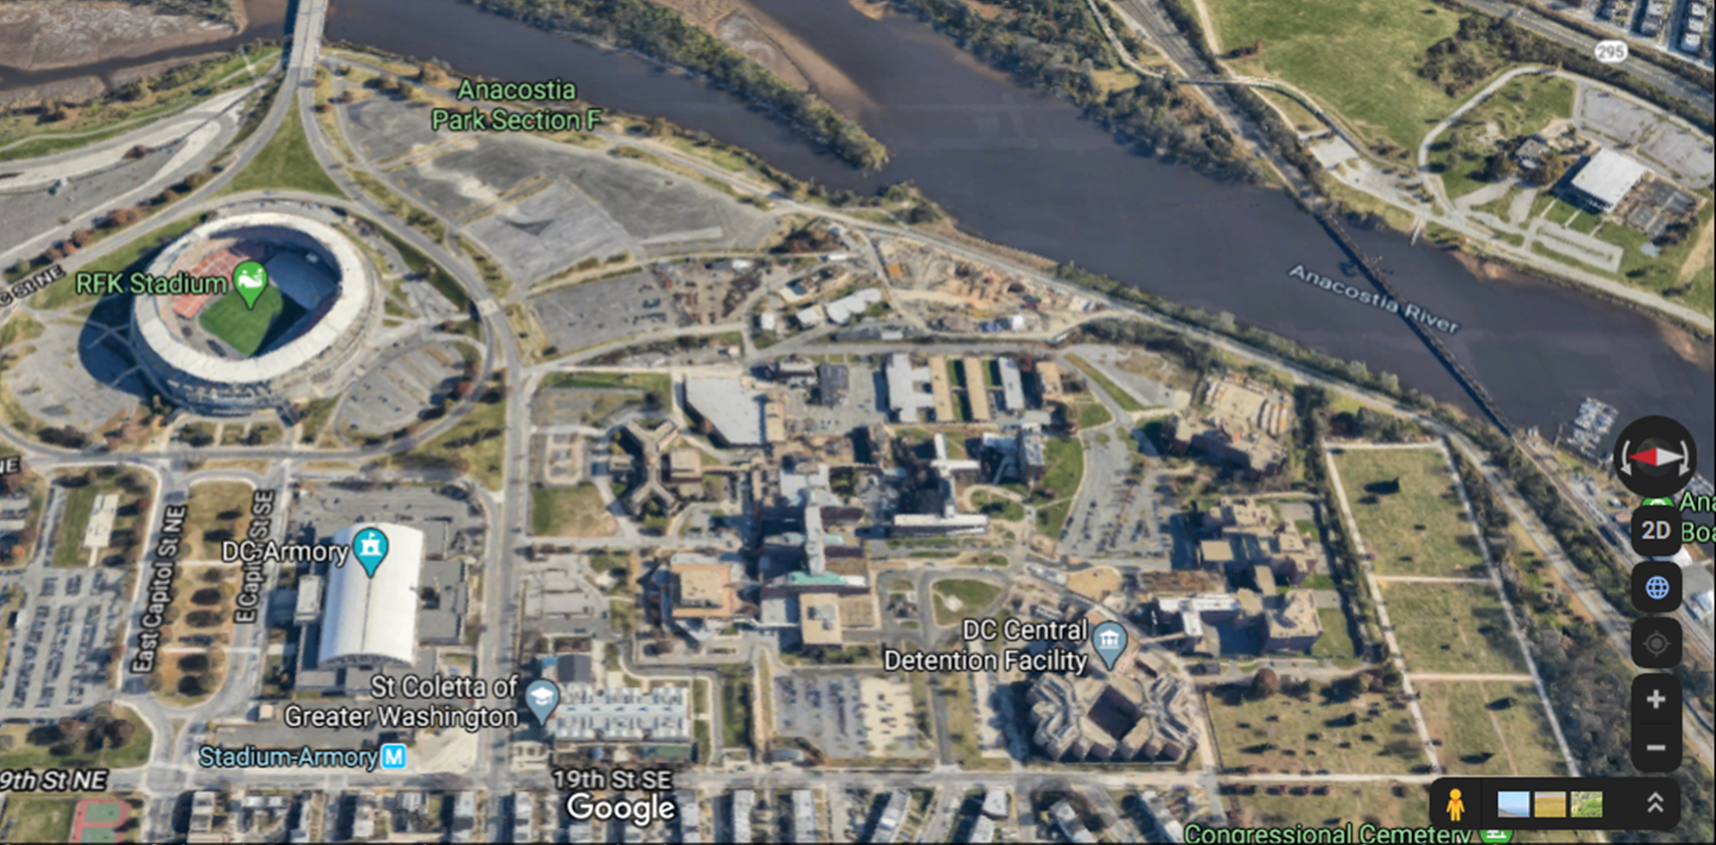
HILL EAST PHASE 2 SURPLUS

Slide 3
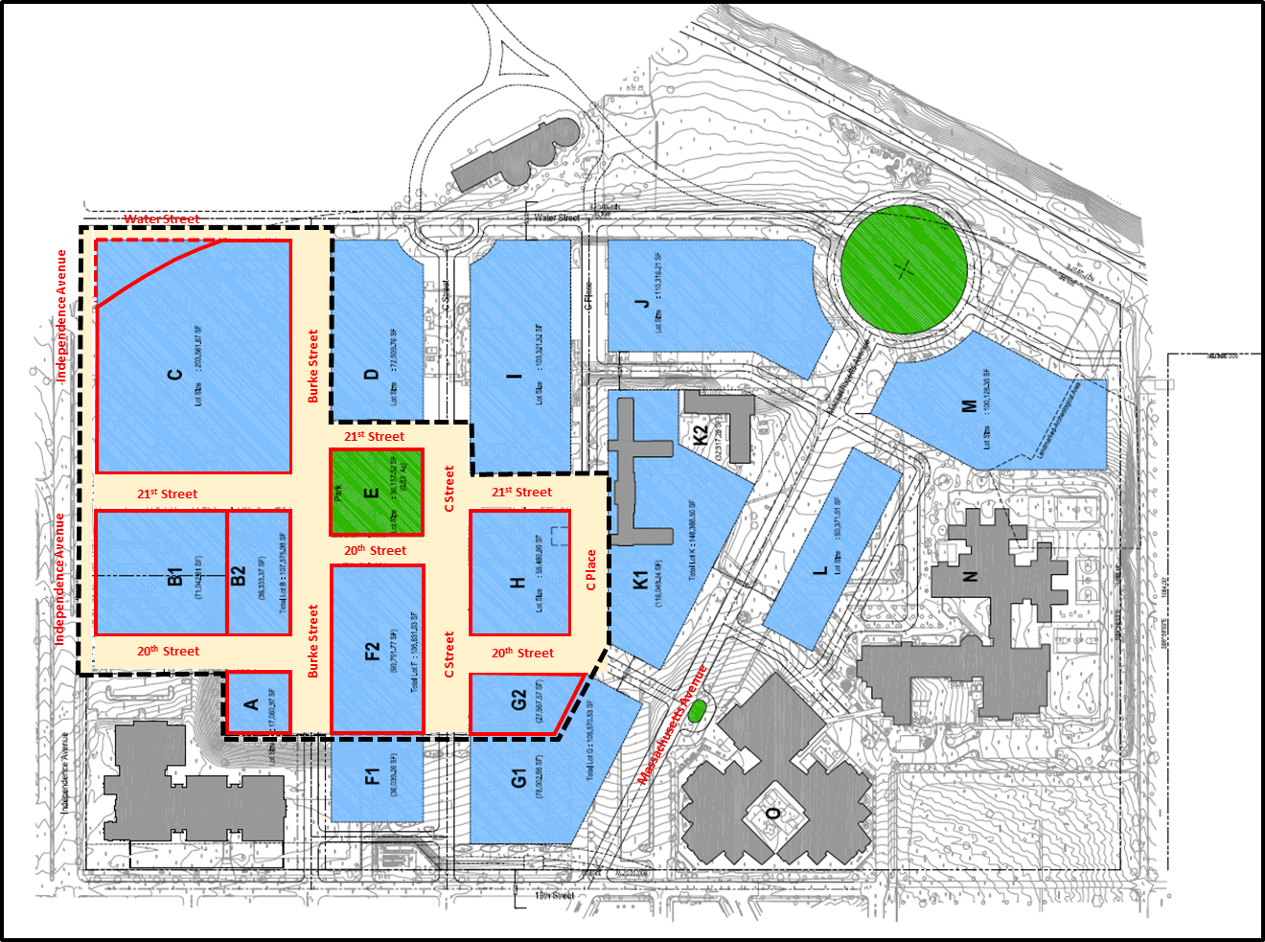
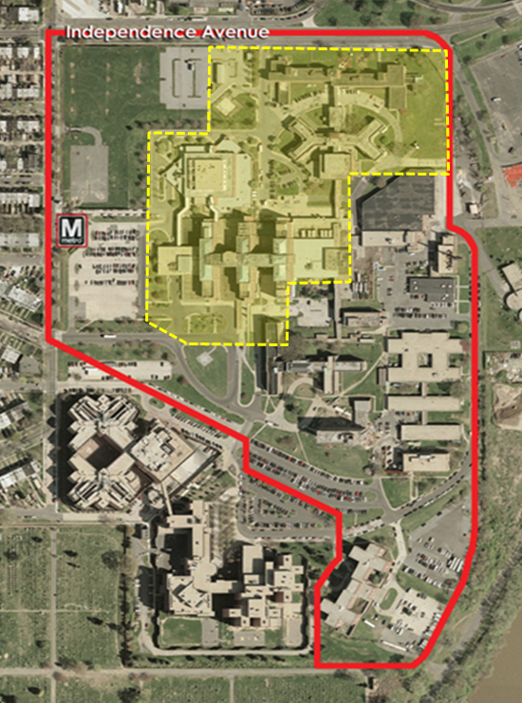
Hill East - Phase 2 Surplus Parcels
Hill East Phase 2 Surplus Parcels

Slide 4
Written comments for the Hill East Phase 2 Surplus should be submitted by September 2, 2020, to:
The Office of the Deputy Mayor for Planning and Economic Development
1350 Pennsylvania Avenue, NW, Suite 317
Washington, DC 20004
Attention: Ketan Gada, Director, Hill East District Redevelopment
Email: ketan.gada@dc.gov
Attention: Daryl Thomas, Development Manager
Email: daryl.thomas@dc.gov

