Slide 1

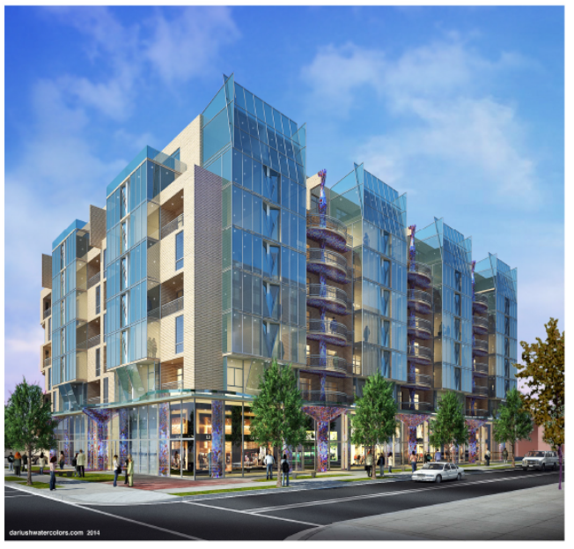
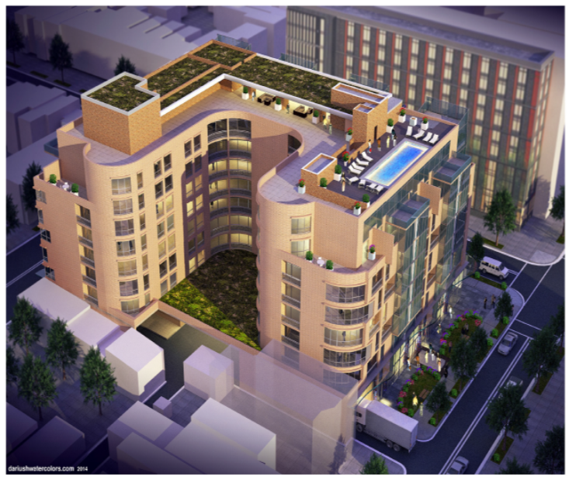
8th & O Street
Notes:
Who are you?
Monjia serves as a Project Manager/Development Associate of Four Points LLC and is primarily responsible for due diligence analysis, financial modeling, construction, and property management. She's done it all--design, construction management, project planning, building commissioning, and property management. A few of her projects include the Ashburn Corporate Data Center (three facilities totaling 852,000 sq. ft.), Children’s Hospital of Philadelphia – South Campus (558,000 sq. ft.), and the Department of Transportation Head Quarters (1.35 million sq. ft.).
Licensed engineer

Slide 2
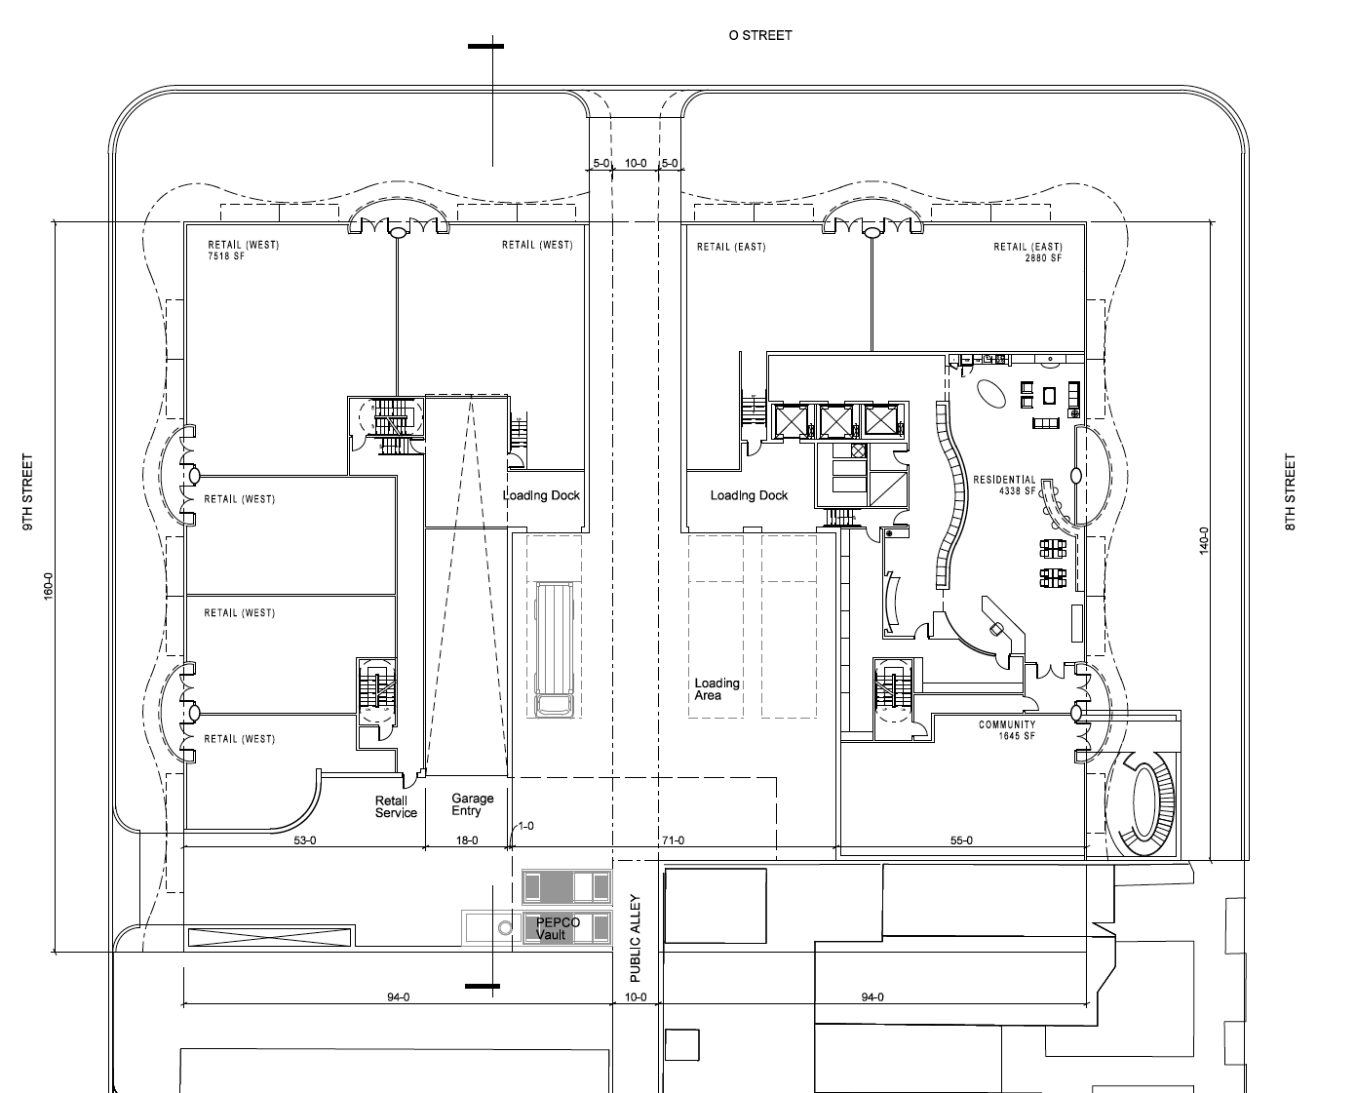

Slide 3
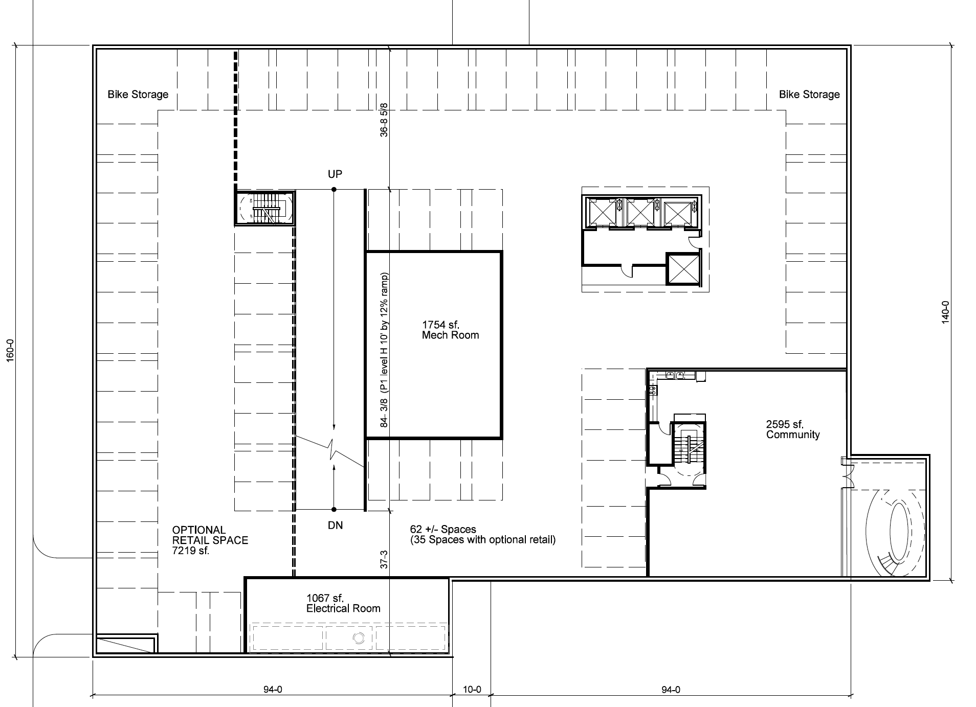

Slide 5
Total Building SF – 267,576 SF
Unit Type – 172 Units (Studios-35 Units, 1BR-92 Units, and 2BR-45 Units)
Affordable Units - 17 Units
Parking - 135 Spaces, 25 spaces assigned to religious institution
Bicycle Parking – Available
Temporary Construction Jobs – 100
Permanent Retail Jobs – 25
Community Center – 4,240 SF; available for use by neighborhood and near by religious institutions
Current Retail – 10,398 SF
Potential Retail – 22,500 SF

Slide 6


Slide 7


